Slide 1
CONCEPT OF COST OF PRODUCTION AND COST CURV
Accounting Costs and Economic Costs
Accountant considers those costs which involve cash payments to others by the entrepreneur of the firm. The accounting costs are contractual cash payments which the firm makes to other factor owners for purchasing or hiring the various factors are also known as explicit costs
The economist takes into account all of these accounting costs, but in addition, he also takes into account the amount of money the entrepreneur could have earned if he had invested his money and sold his own services and other factors in next best alternative use and also known as implicit costs or imputed costs.
Economic Costs = Accounting Costs + Implicit Costs.
The normal return on money-capital invested by the entrepreneur and the wages or salary for his services and the money rewards for other factors which the entrepreneur himself owns and employs them in his own firm are known as implicit costs or imputed costs.
Economic Profits = Total Revenue – Total Economic Costs

Slide 2
Continue…
Opportunity Cost
Professor Benham defines the opportunity costs thus : “the opportunity cost of anything is the next best alternative that could be produced instead by the same factors or by a equivalent group of factors, costing the same amount of money.
Private Cost Versus Social Cost
The production of a commodity by a firm bestows some benefits or causes some damage or loss to others which he does not take into account while taking decisions regarding price and output of the commodity.
The social costs are the sum of the private costs and the net of negative externalities over positive externalities.
If there are no any negative externalities, social cost will be greater than private costs

Slide 3
Continue…
Opportunity Cost
Professor Benham defines the opportunity costs thus : “the opportunity cost of anything is the next best alternative that could be produced instead by the same factors or by a equivalent group of factors, costing the same amount of money”.
Private Cost Versus Social Cost
The production of a commodity by a firm bestows some benefits or causes some damage or loss to others which he does not take into account while taking decisions regarding price and output of the commodity.
The social costs are the sum of the private costs and the net of negative externalities over positive externalities

Slide 4
Continue…
Short Run and Long Run Defined
Factors such as labor, raw materials, chemicals etc., which can be readily varied with the change in output are called variable factors.
Factors such as capital equipment, factory building which cannot be readily varied and require comparatively a long time to make adjust- ment in them are called fixed factors.
The short run is a period of time in which output can be increased or decreased by changing only the amount of variable factors such as labour, raw materials, chemicals, etc.
On the other hand, in the long run, quantities of the fixed factors such as capital equipment, factory building, etc., can also be varied for making changes in output.

Slide 5
Continue…
Short Run Costs : Total Fixed and Variable Costs
Fixed costs are those which are independent of output, that is, they do not change with changes in output. These costs are a fixed amount which must be incurred by a firm in the short run, whether output is small or large. Thus fixed costs are those which are incurred in hiring the fixed factors of production whose amount cannot be altered in the short run.
Fixed costs are also known as overhead costs and include charges such as contractual rent, insurance fee, maintenance costs, property taxes, interest on the capital invested, minimum administrative expenses such as manager’s salary, watchman’s wages etc

Slide 6
Continue…
Variable costs, on the other hand, are those costs which are incurred on the employment of variable factors of production whose amount can be altered in the short run. Thus the total variable costs change with changes in output in the short run, i.e., they increase or decrease when the output rises or falls.
Variable costs are also called prime costs or direct costs. These costs include payments such as wages of labor employed, prices of the raw materials, fuel and power used, the expenses incurred on transporting and the like
Total costs of a business is the sum of its total variable costs and total fixed costs. Thus:
TC = TFC + TVC
where TC stands for total cost, TFC for total fixed cost and TVC for total variable cost.

Slide 7
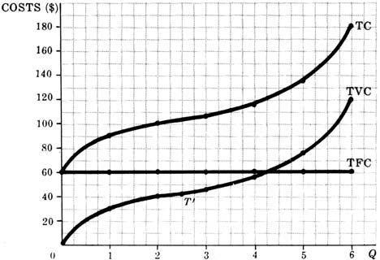
Continue…
Total costs of a business is the sum of its total variable costs and total fixed costs. Thus:
TC = TFC + TVC
where TC stands for total cost, TFC for total fixed cost and TVC for total variable cost.
Q | TFC ($) | TVC ($) | TC ($)
0 | 60 | 0 | 60
1 | 60 | 30 | 90
2 | 60 | 40 | 100
3 | 60 | 45 | 105
4 | 60 | 55 | 115
5 | 60 | 75 | 135
6 | 60 | 120 | 180

Slide 8
Total fixed cost and total variable costs are portrayed in Fig. 19.1 where output is measured on the X-axis and cost on the Y-axis.
It should be noted that total cost (TC) is a function of total output (Q); the greater the output, the greater will be the total cost. In symbols, we can write:
Total Cost (TC) = f(Q)
We can prove this as follows :
TC = TFC + TVC.
Suppose TFC is equal to K which is a constant amount whatever the level of output. TVC is equal to the amount used of the variable factor, say, L, multiplied by the given price of the variable, say, w
TVC = L.w . . . (i)
TC = K + L.w . . . (ii)

Slide 9
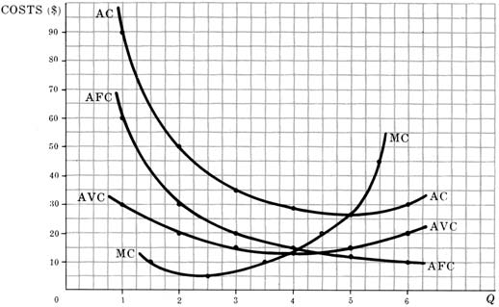
SHORT-RUN PER-UNIT COST CURVES
Although total cost curves are very important, per-unit cost curves are even more important in the short-run analysis of the firm. The short-run per-unit cost curves that we will consider are the average fixed cost, the average variable cost, the average cost, and the marginal cost curves.
Average fixed cost (AFC) equals total fixed costs divided by output. Average variable cost (AVC) equals total variable costs divided by output. Average cost (AC) equals total costs divided by output; AC also equals AFC plus AVC. Marginal cost (MC) equals the change in TC or the change in TVC per unit change in output.
(1) | (2) | (3) | (4) | (5) | (6) | (7) | (8)
Q | TFC ($) | TVC ($) | TC ($) | AFC ($) | AVC ($) | AC ($) | MC ($)
1 | 60 | 30 | 90 | 60 | 30.00 | 90.00 | ..
2 | 60 | 40 | 100 | 30 | 20.00 | 50.00 | 10
3 | 60 | 45 | 105 | 20 | 15.00 | 35.00 | 5
4 | 60 | 55 | 115 | 15 | 13.75 | 28.75 | 10
5 | 60 | 75 | 135 | 12 | 15.00 | 27.00 | 20
6 | 60 | 120 | 180 | 10 | 20.00 | 30.00 | 45

Slide 10
The Relationship between Marginal Cost and Marginal Product of a Variable Factor
AP
MP
X
Quantity of Labour
MC
Q1
Q2
AVC

